Slide 1
AURA Cosmetics
INVENTORY MANAGEMENT SYSTEM
Team Members
Anjali Yamdagni
Aparna Raghavendra Rao
Nirmali Das
Xin Lan
DECEMBER 7, 2022

Slide 2

Overview
Emerging brand looking to meet their customer needs by scaling up manufacturing & distribution systems
Data Sources
-Inventory File containing details about quantity of product
-Order and Invoice Information
-Customer information shared via files generated by hypothetical data partners
About our System
End Users
-Executive Members at firm
-Line Managers

Slide 3
Managing Inventory for timely fulfillment of orders, replenishment of the stocks to attain higher customer satisfaction and profits
Mission Statement & Objective
To provide accurate data to analyze product performance & other metrics like sales trends
Maintaining a record of goods returned to keep a check on quality control and maximize customer satisfaction
To provide customer insights to the management to make executive decisions
Keeping a track of the orders to analyze demand

Slide 4
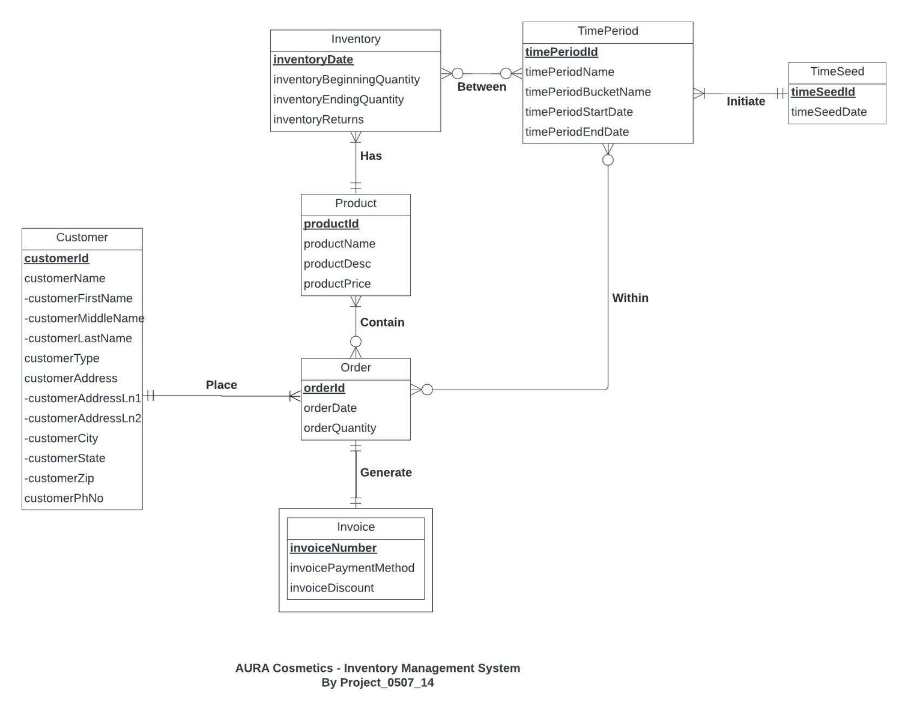
01
Conceptual
Database Design

Slide 5
Product (productId, productName, productDesc, productPrice)
Customer (customerId, customerFirstName, customerMiddleName, customerLastName, customerType, customerAddressLn1, customerAddressLn2, customerCity, customerState, customerZip, customerPhNo)
Order (orderId, orderDate, orderQuantity,customerId)
Invoice (invoiceNumber, invoicePaymentMethod, invoiceDiscount, orderId)
Inventory (inventoryDate, productId, inventoryBeginningQuantity, inventoryEndingQuantity, inventoryReturns)
TimeSeed (timeSeedId, timeSeedDate)
TimePeriod (timePeriodId, timePeriodName, timePeriodBucketName, timePeriodStartDate, timePeriodEndDate)
Within (orderId, timePeriodId)
Between (inventoryDate,ProductId timePeriodId)
Contain (productId,orderId)
02
Logical
Database
Design

Slide 6
03
Physical Database
Design
CREATE TABLE [AuraCosmetics.Order] (
orderId VARCHAR (20) NOT NULL,
orderDate DATE,
orderQuantity INTEGER,
customerId CHAR(11) NOT NULL,
CONSTRAINT pk_order_orderId PRIMARY KEY (orderId),
CONSTRAINT fk_order_customerId FOREIGN KEY (customerId)
REFERENCES [AuraCosmetics.Customer] (customerId)
ON DELETE NO ACTION ON UPDATE CASCADE);

Slide 7
SELECT t.timePeriodBucketName,t.timePeriodId, t.timePeriodName, p.productDesc,
SUM(o.orderQuantity) AS 'orderQuantity'
FROM [AuraCosmetics.Order] o , [AuraCosmetics.Within] w, [AuraCosmetics.TimePeriod] t ,
[AuraCosmetics.Contain] c, [AuraCosmetics.Product] p
WHERE o.orderId = w.orderId AND w.timePeriodId = t.timePeriodId AND o.orderId =
c.orderId AND c.productId = p.productId
GROUP BY t.timePeriodId, t.timePeriodName, p.productDesc, t.timePeriodBucketName
HAVING t.timePeriodBucketName = 'Rolling 6 Months'
ORDER BY t.timePeriodId DESC;
04
What is the number of orders for the past 6 months?

Slide 8
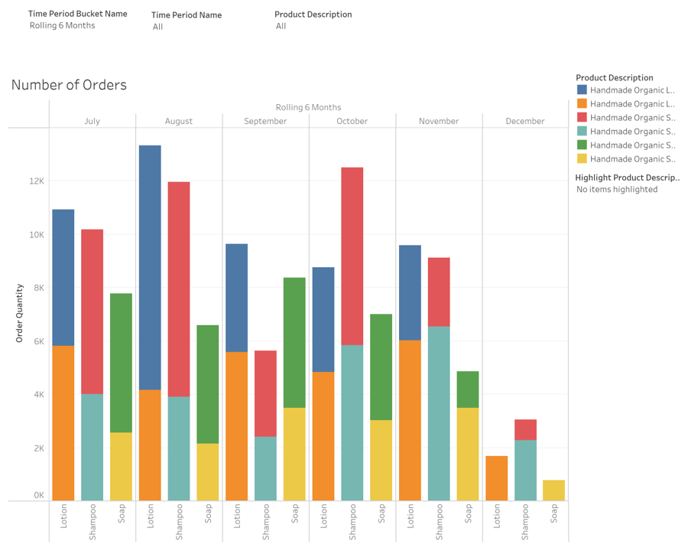
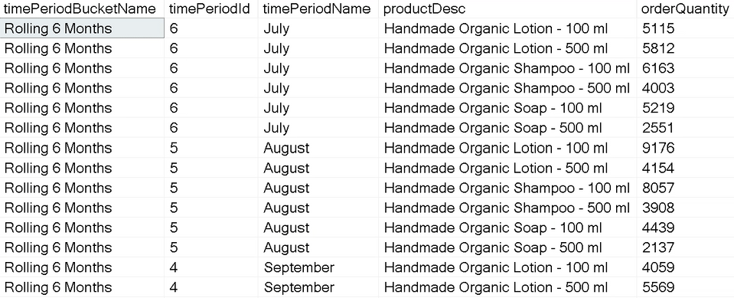
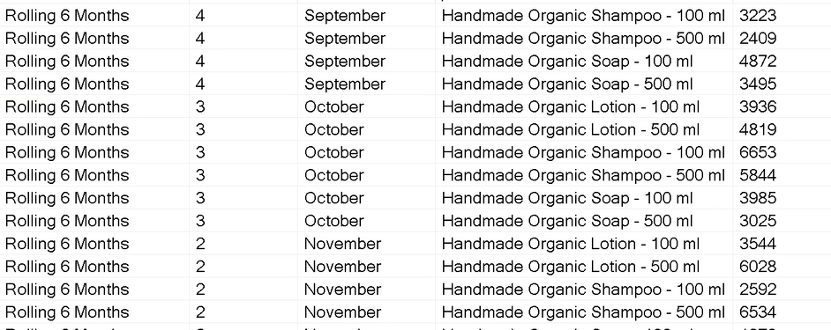
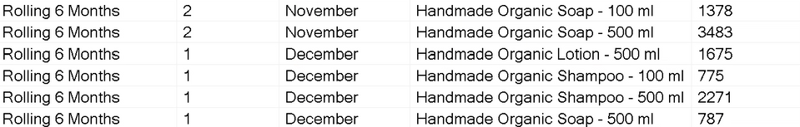
What is the number of orders for the past 6 months?

Slide 9
05
What is the best performing product by ranking product based on the number of orders for each product?
SELECT o.productId,p.productName,p.productDesc, DENSE_RANK() OVER (ORDER BY orderCount DESC) AS 'Product Rank'
FROM
(SELECT c.productId, COUNT(o.orderId) AS 'orderCount'
FROM [AuraCosmetics.order] o , [AuraCosmetics.Contain] c
WHERE o.orderId = c.orderId
GROUP BY c.productId
) o , [AuraCosmetics.Product] p
WHERE o.productId = p.productId

Slide 10
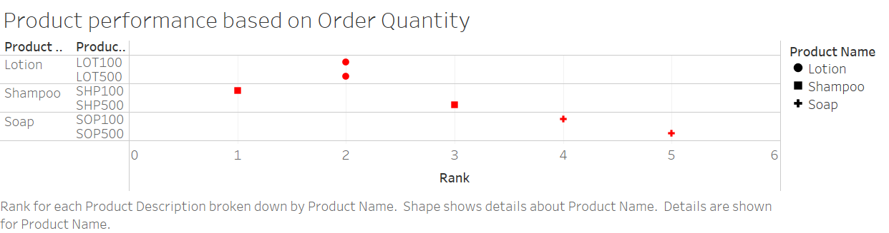
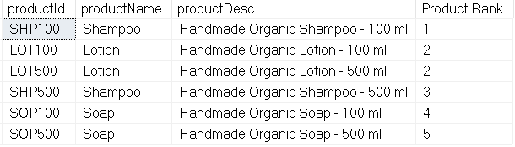
What is the best performing product by ranking product based on the number of orders for each product?

Slide 11

Thank You

Slide 12
DATE & TIME FUNCTIONS https://learn.microsoft.com/en-us/sql/t-sql/functions/date-and-time-data-types-and-functions-transact-sql?view=sql-server-ver16
References
SAMPLE DATA MOCKUP
https://mockaroo.com/
Textbook
Jeffrey A. Hoffer, V. Ramesh, Heikki Topi - Modern Database Management-Pearson (2017)

